Slide 1


Slide 2
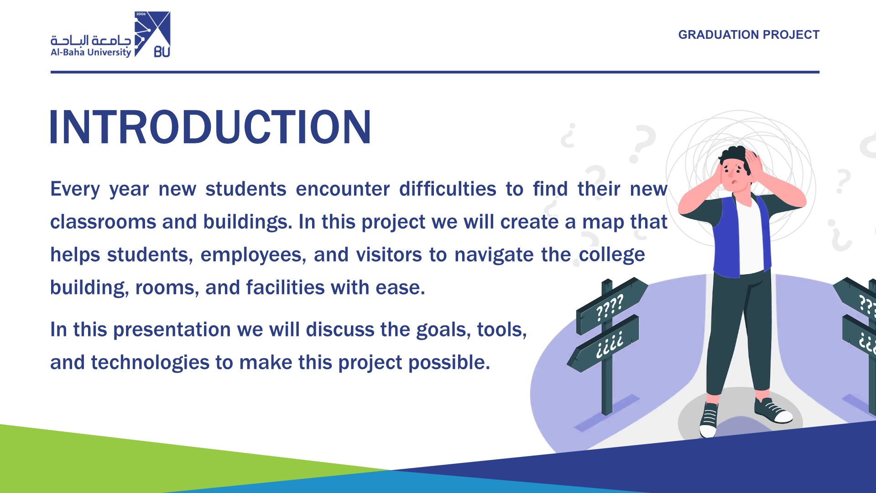

Slide 3
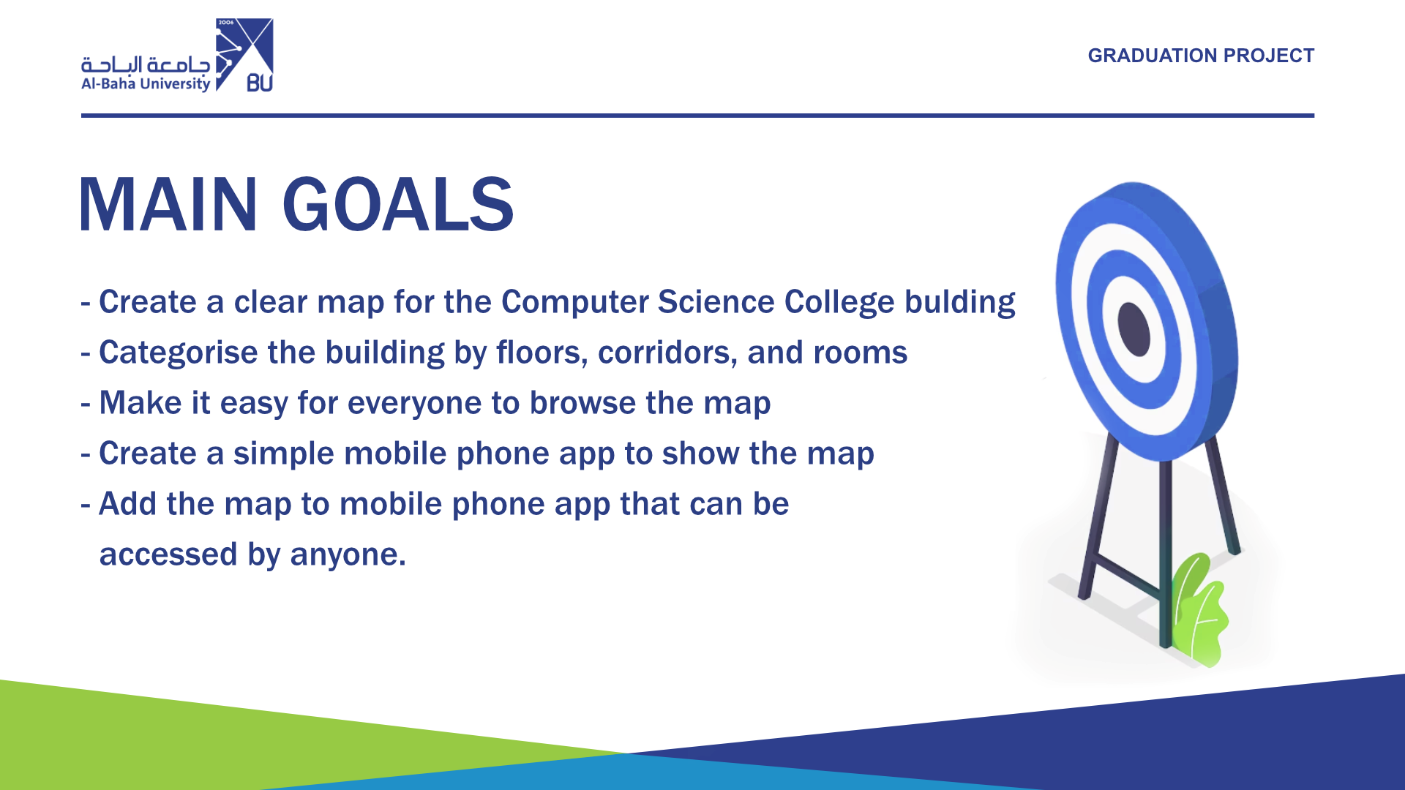

Slide 4
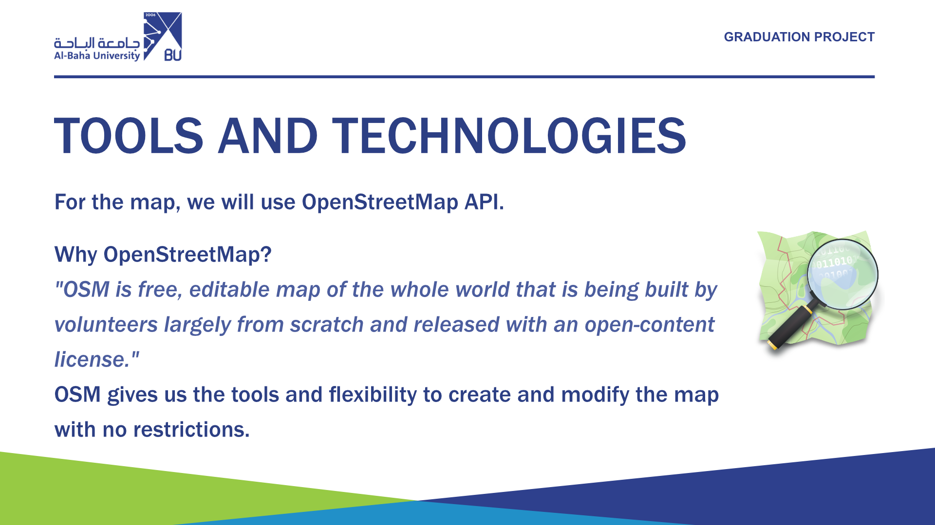

Slide 5
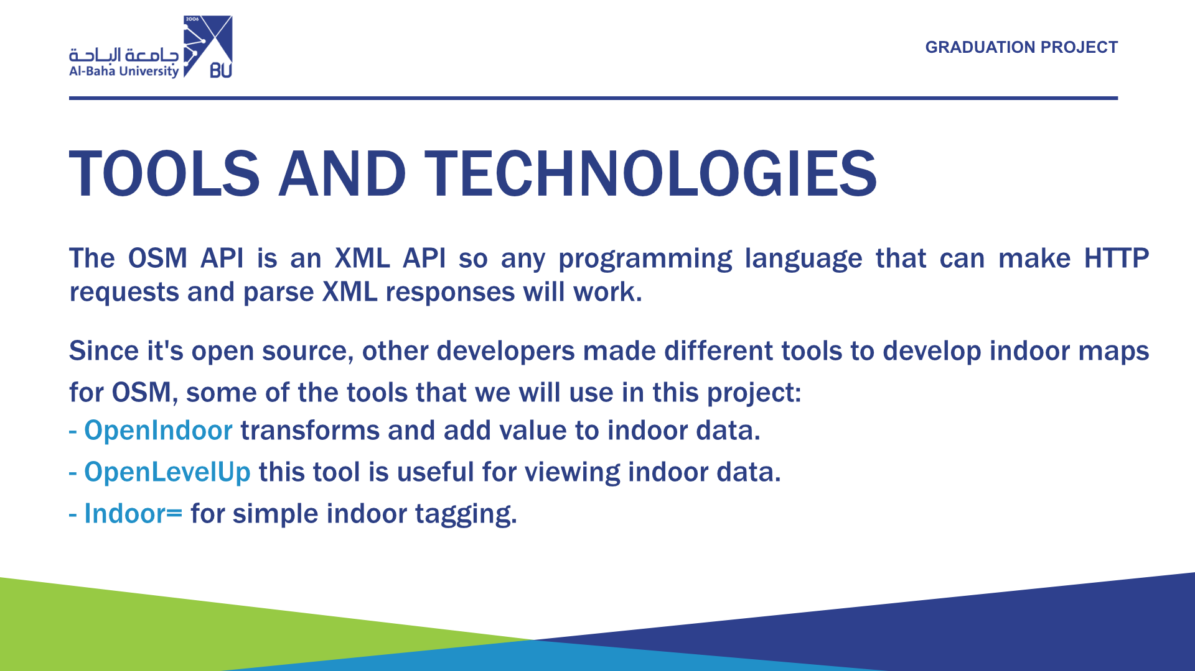

Slide 6
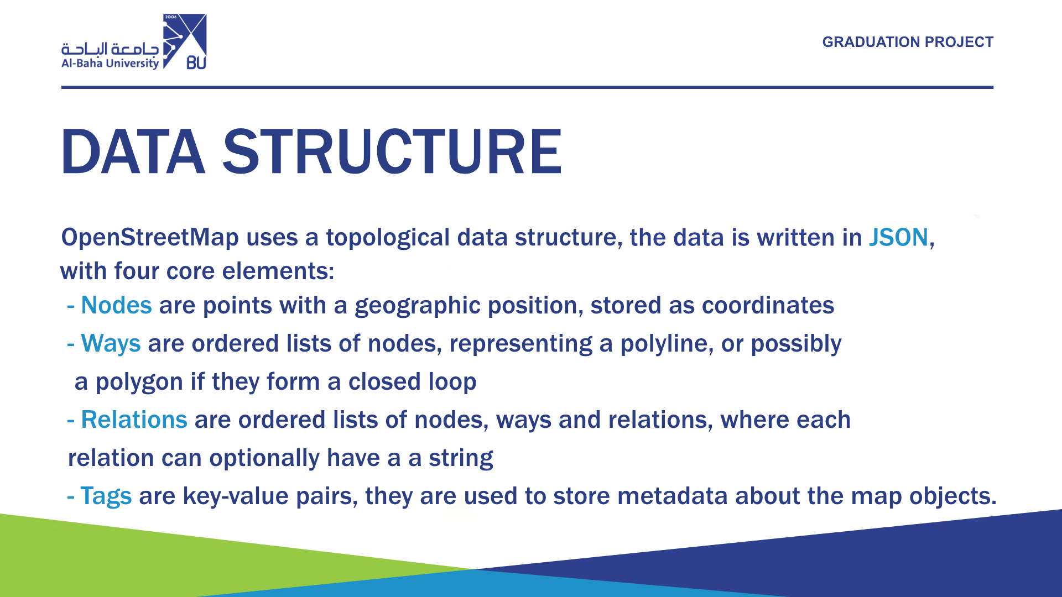

Slide 7
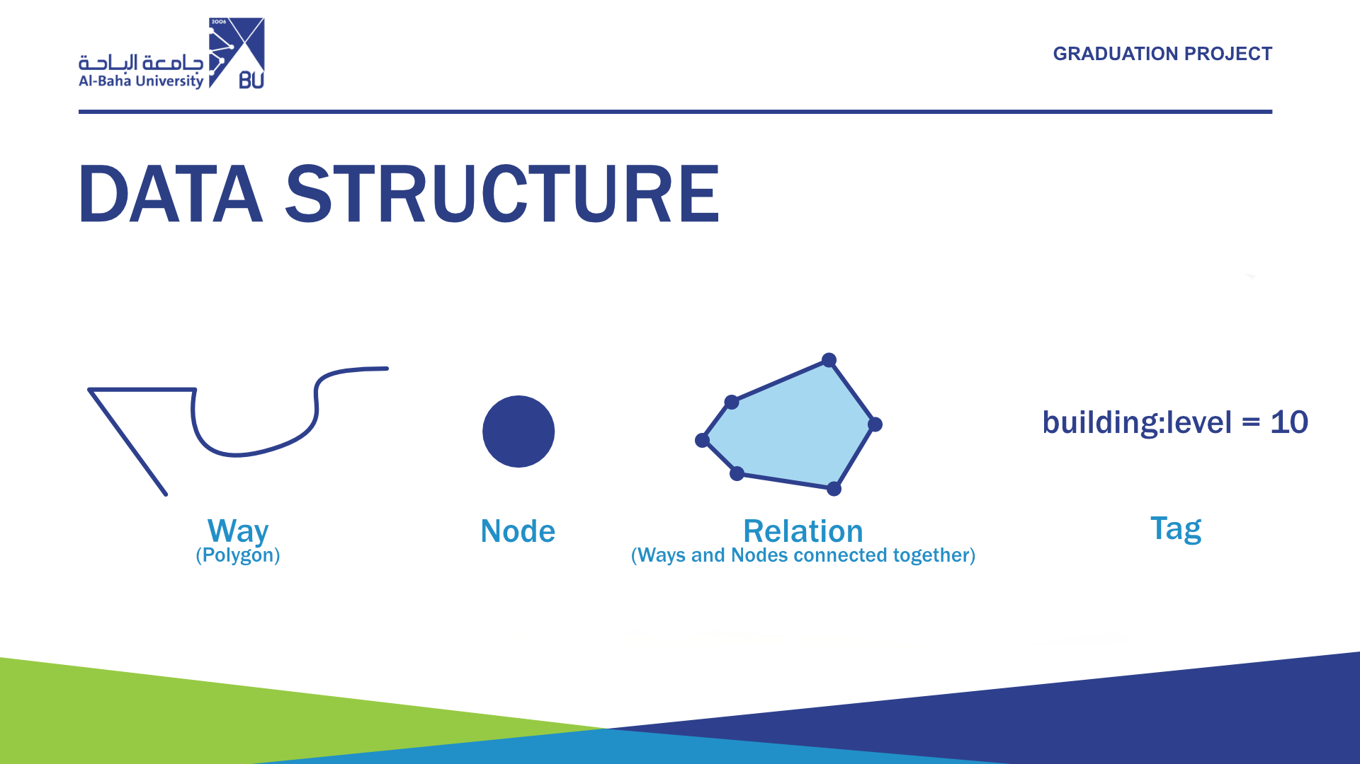

Slide 8
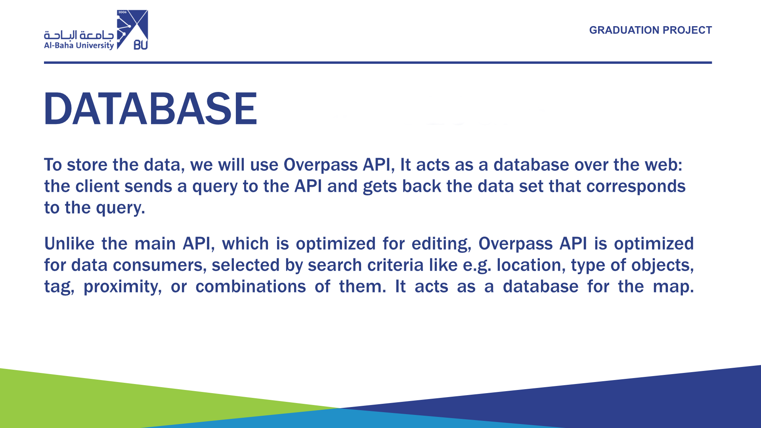

Slide 9
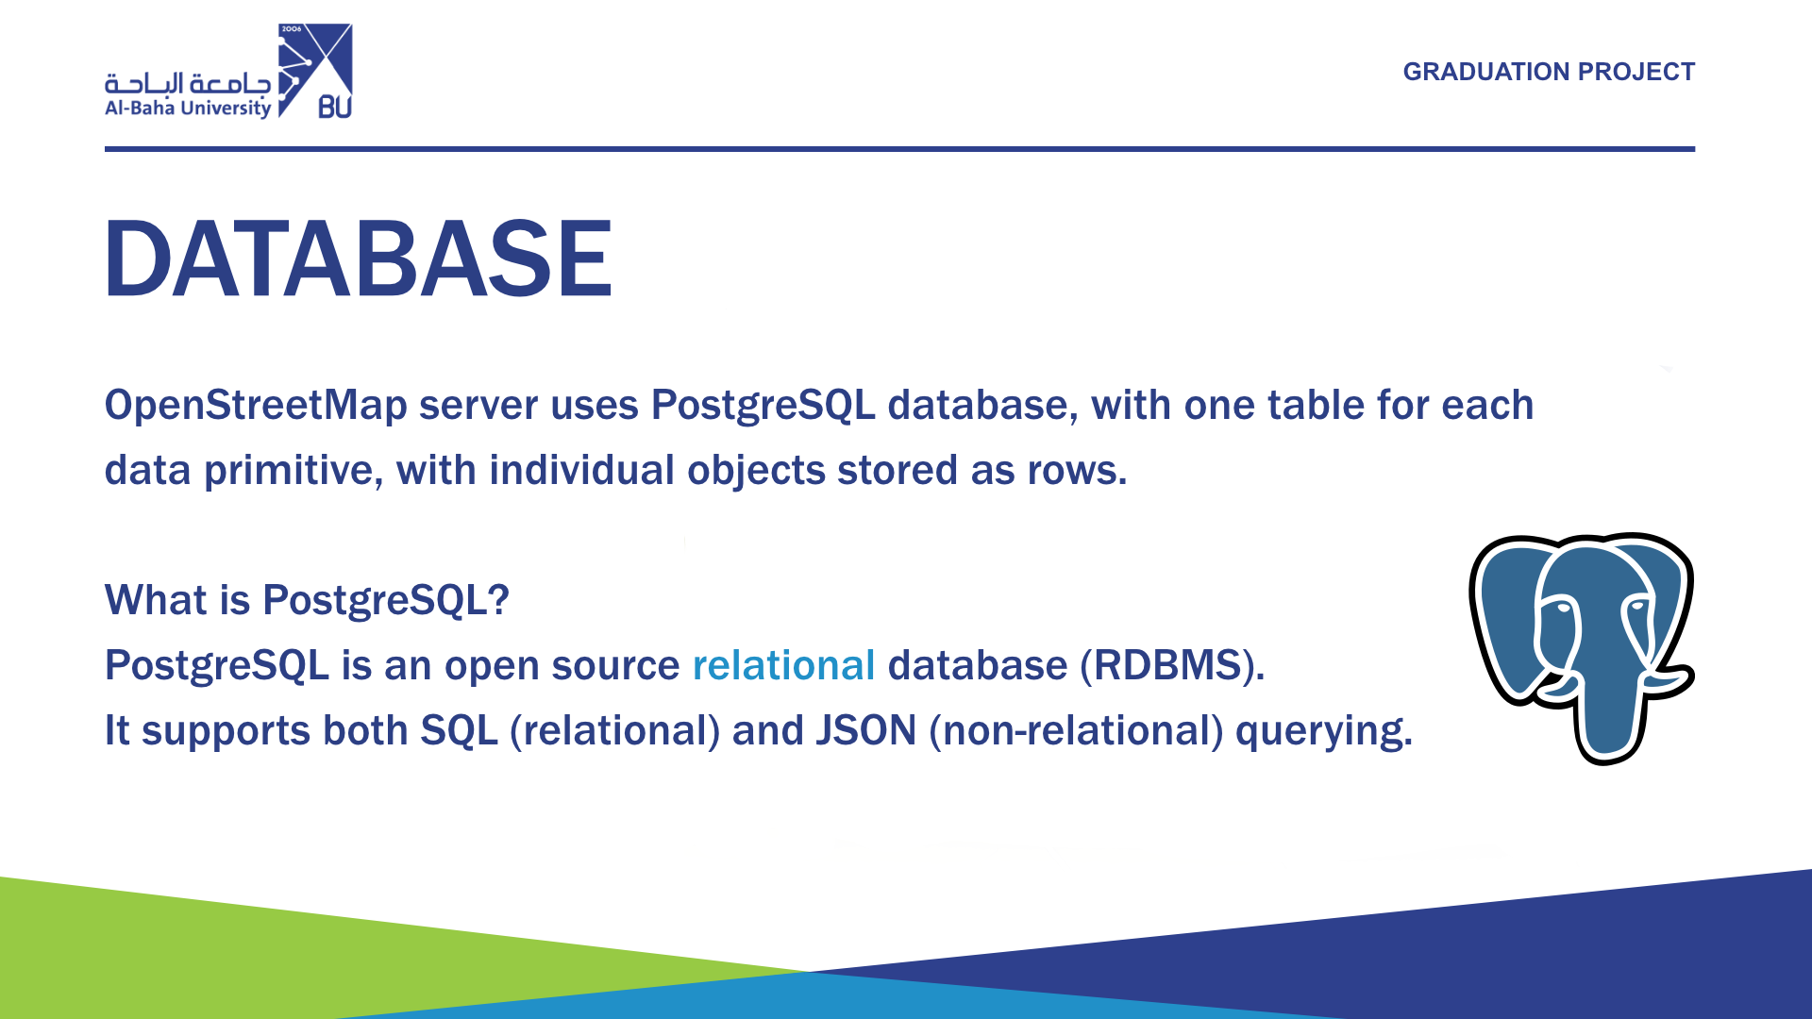

Slide 10
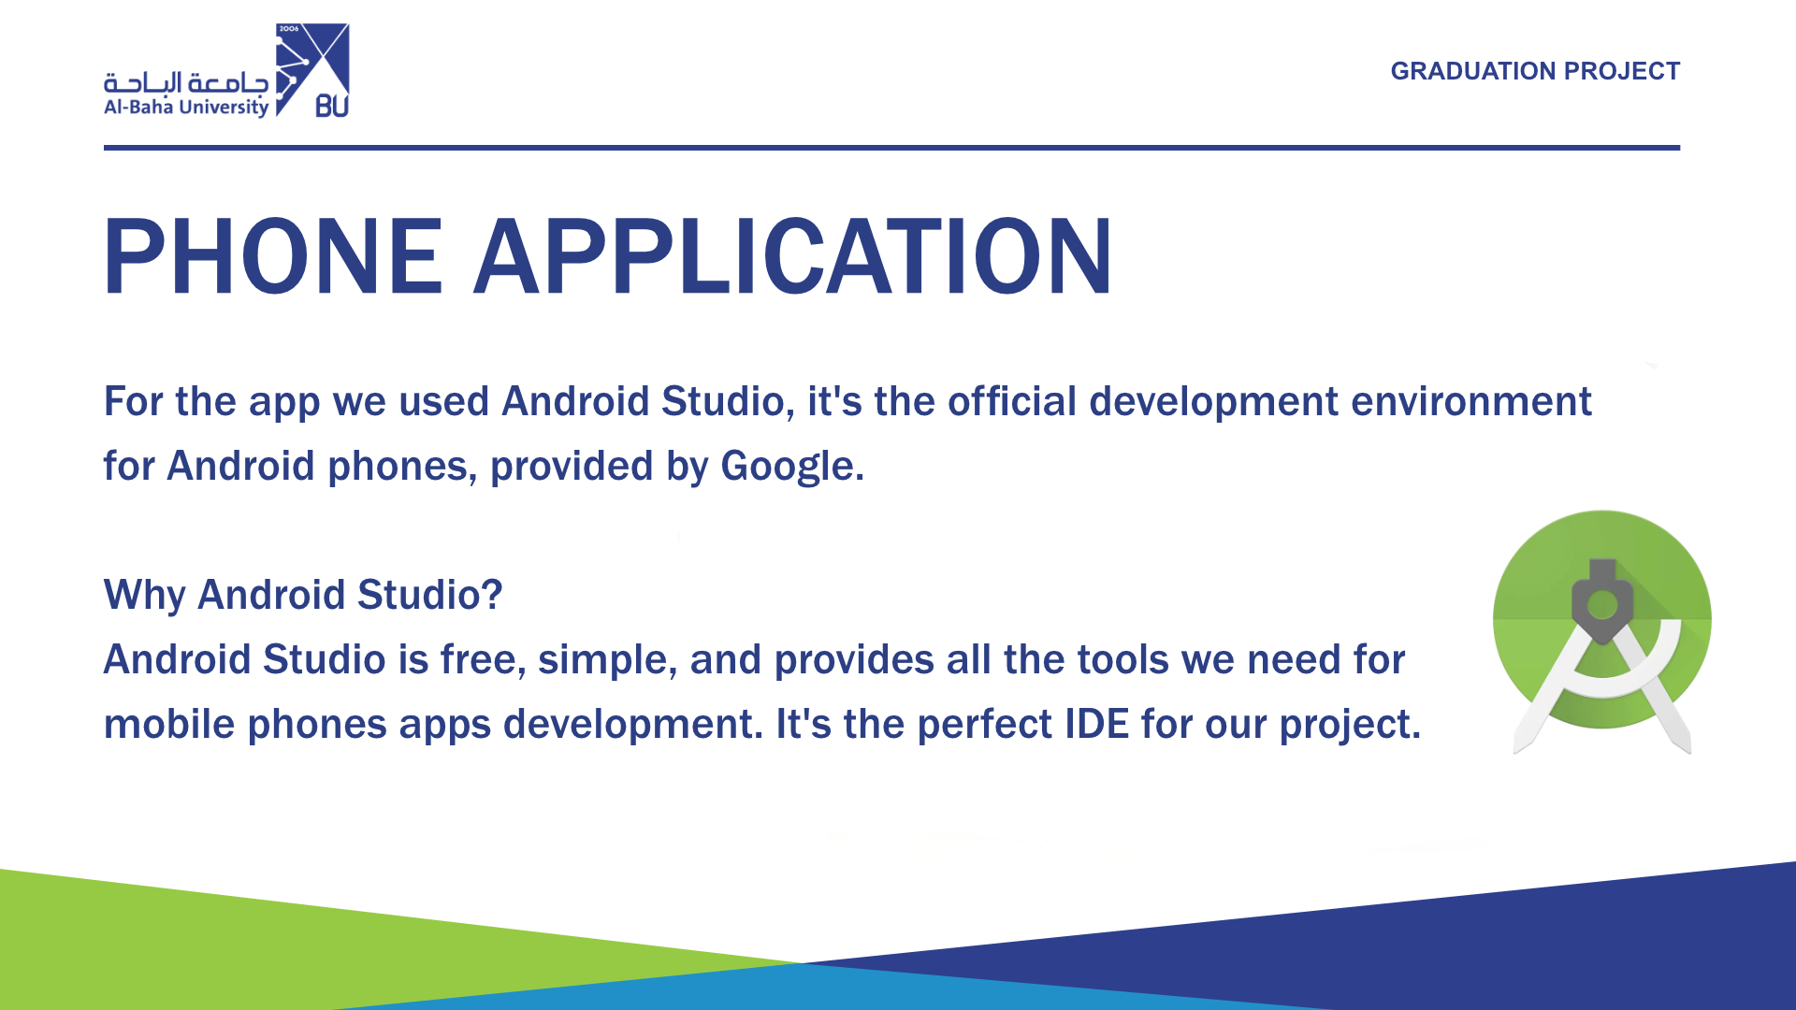

Slide 11
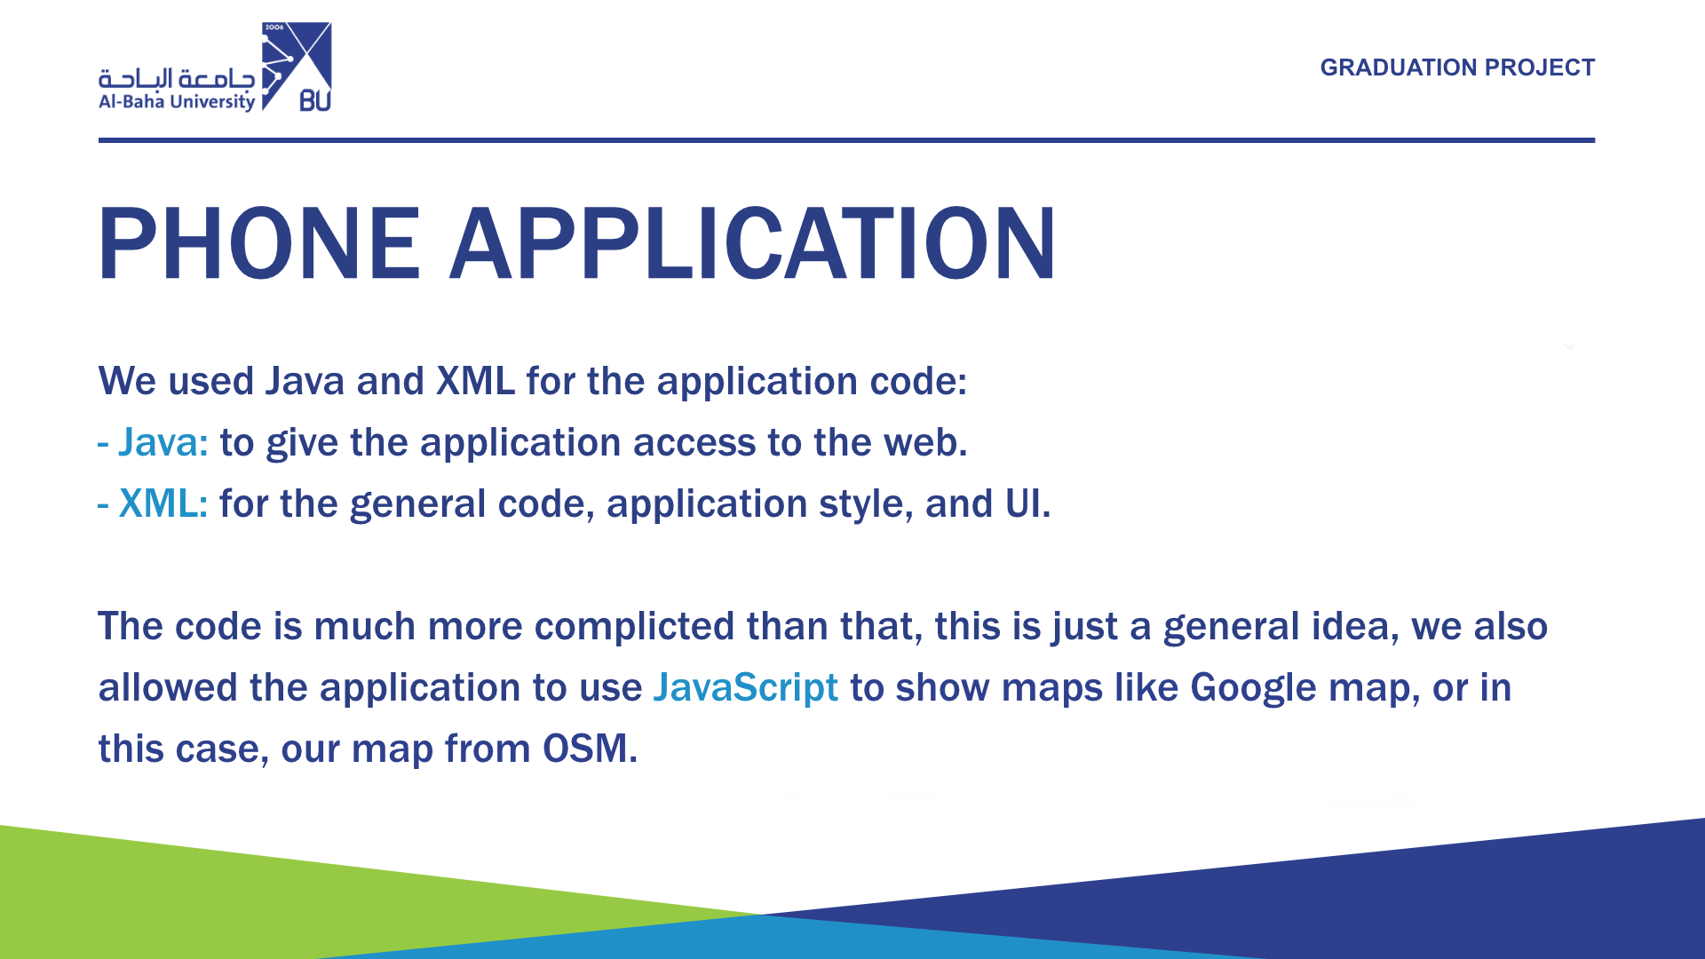

Slide 12
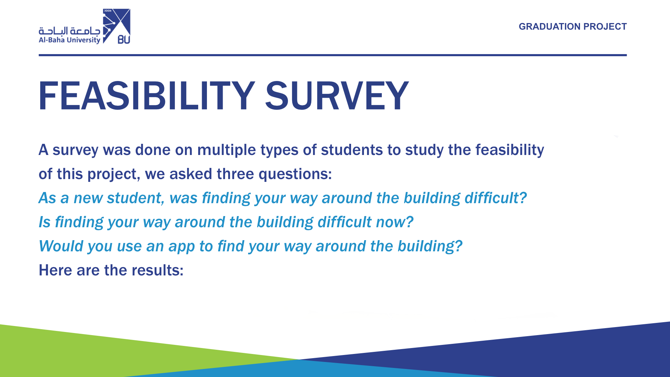

Slide 13
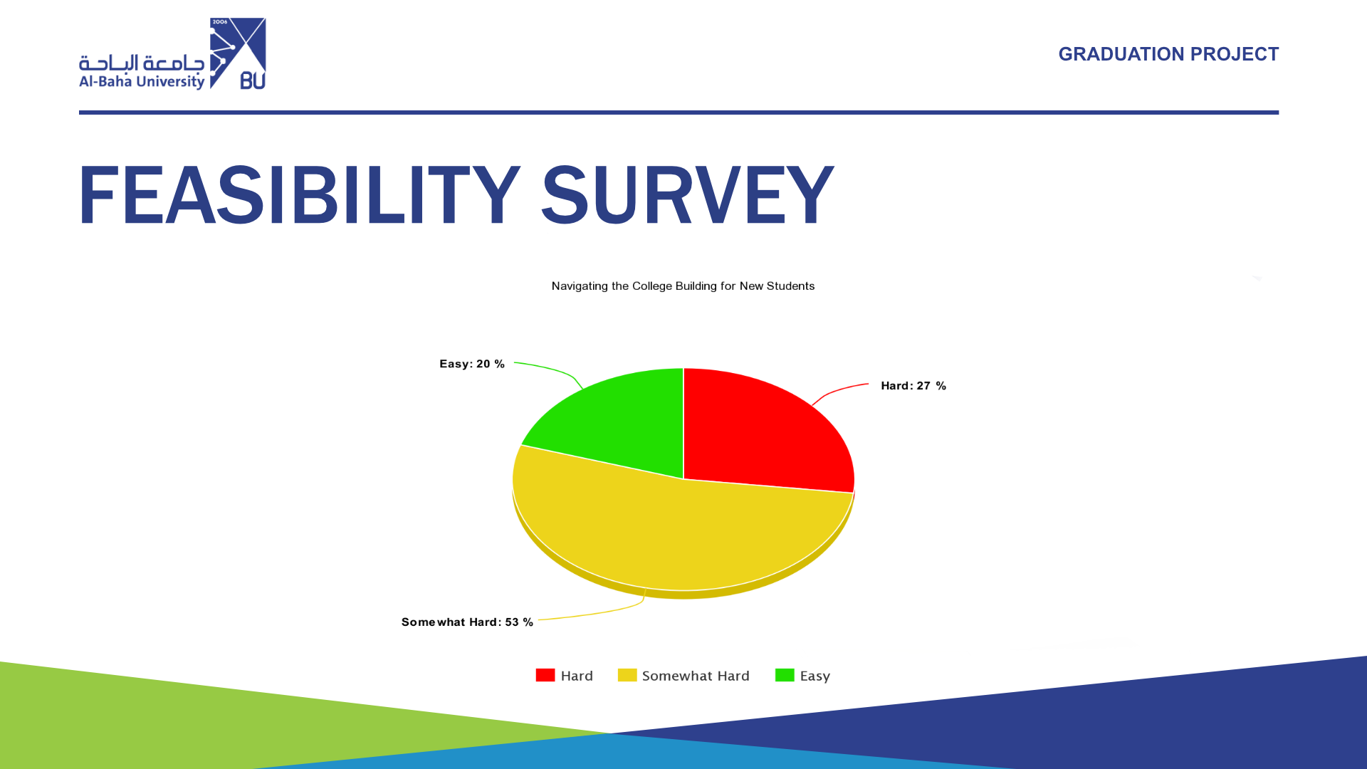

Slide 14
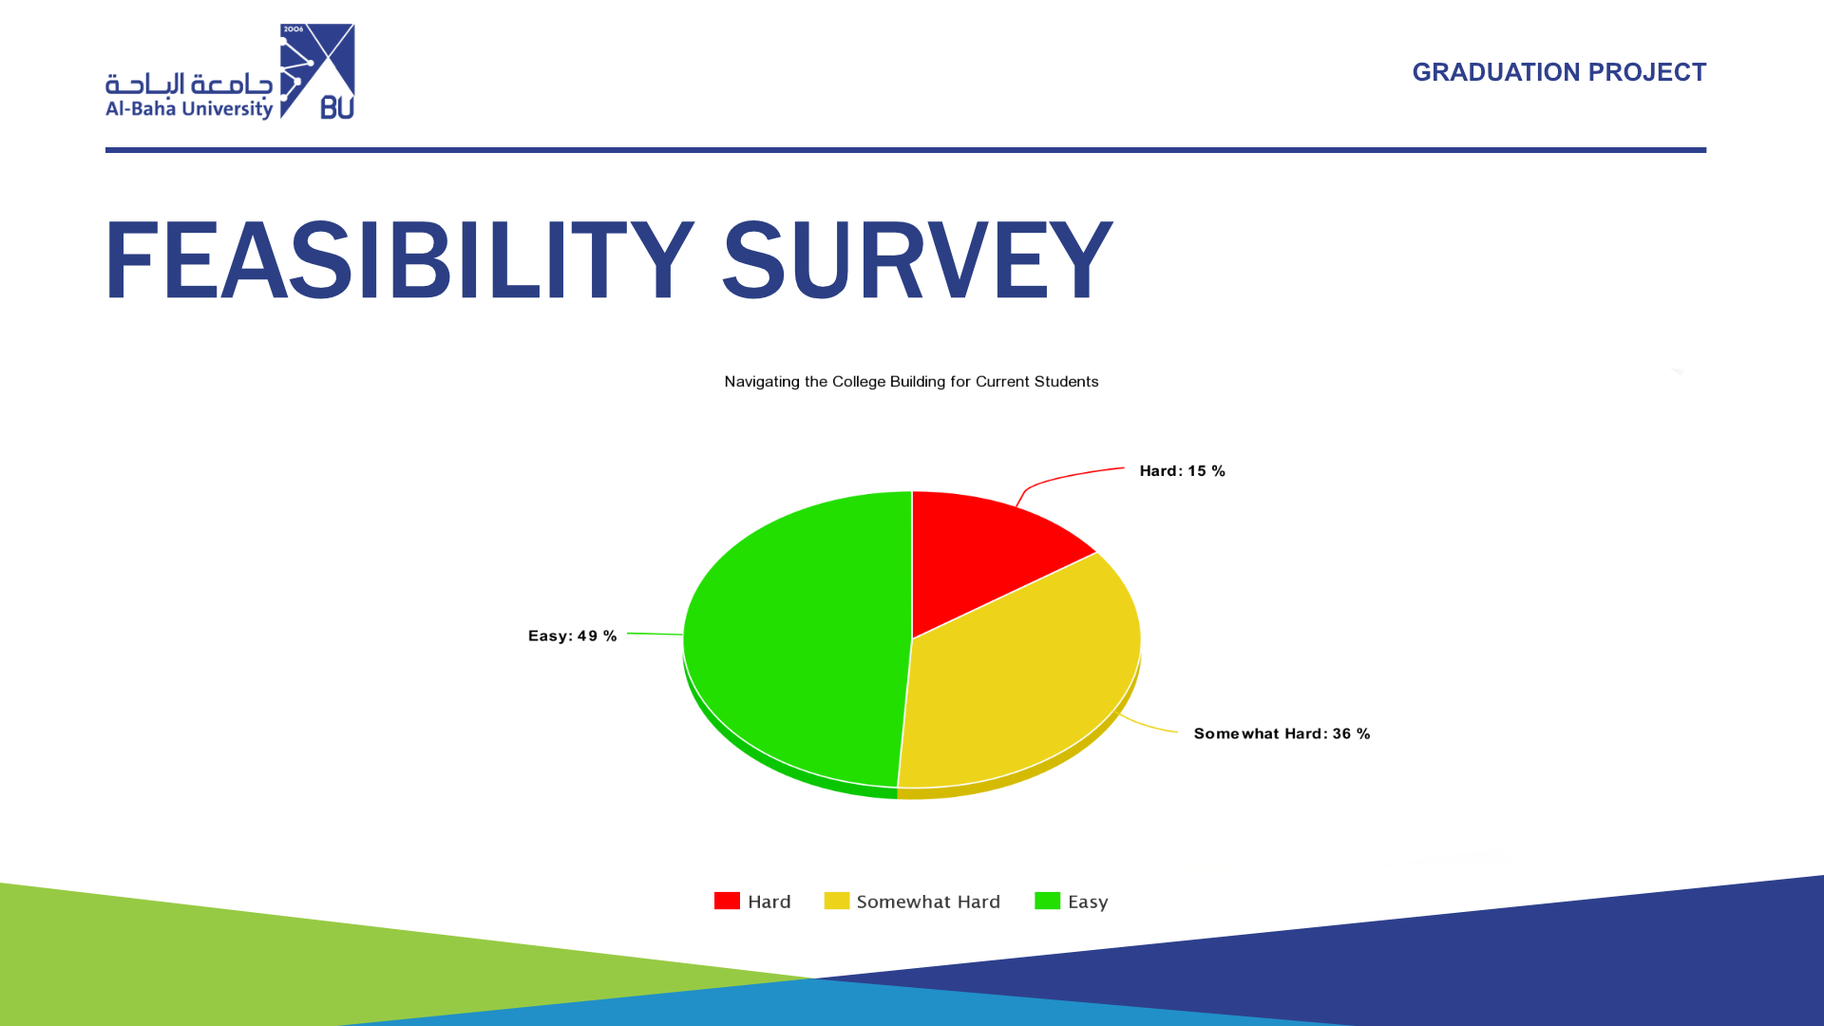

Slide 15
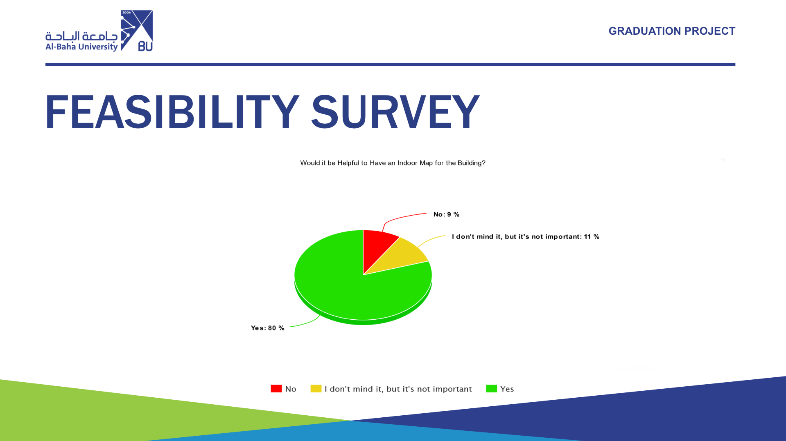

Slide 16
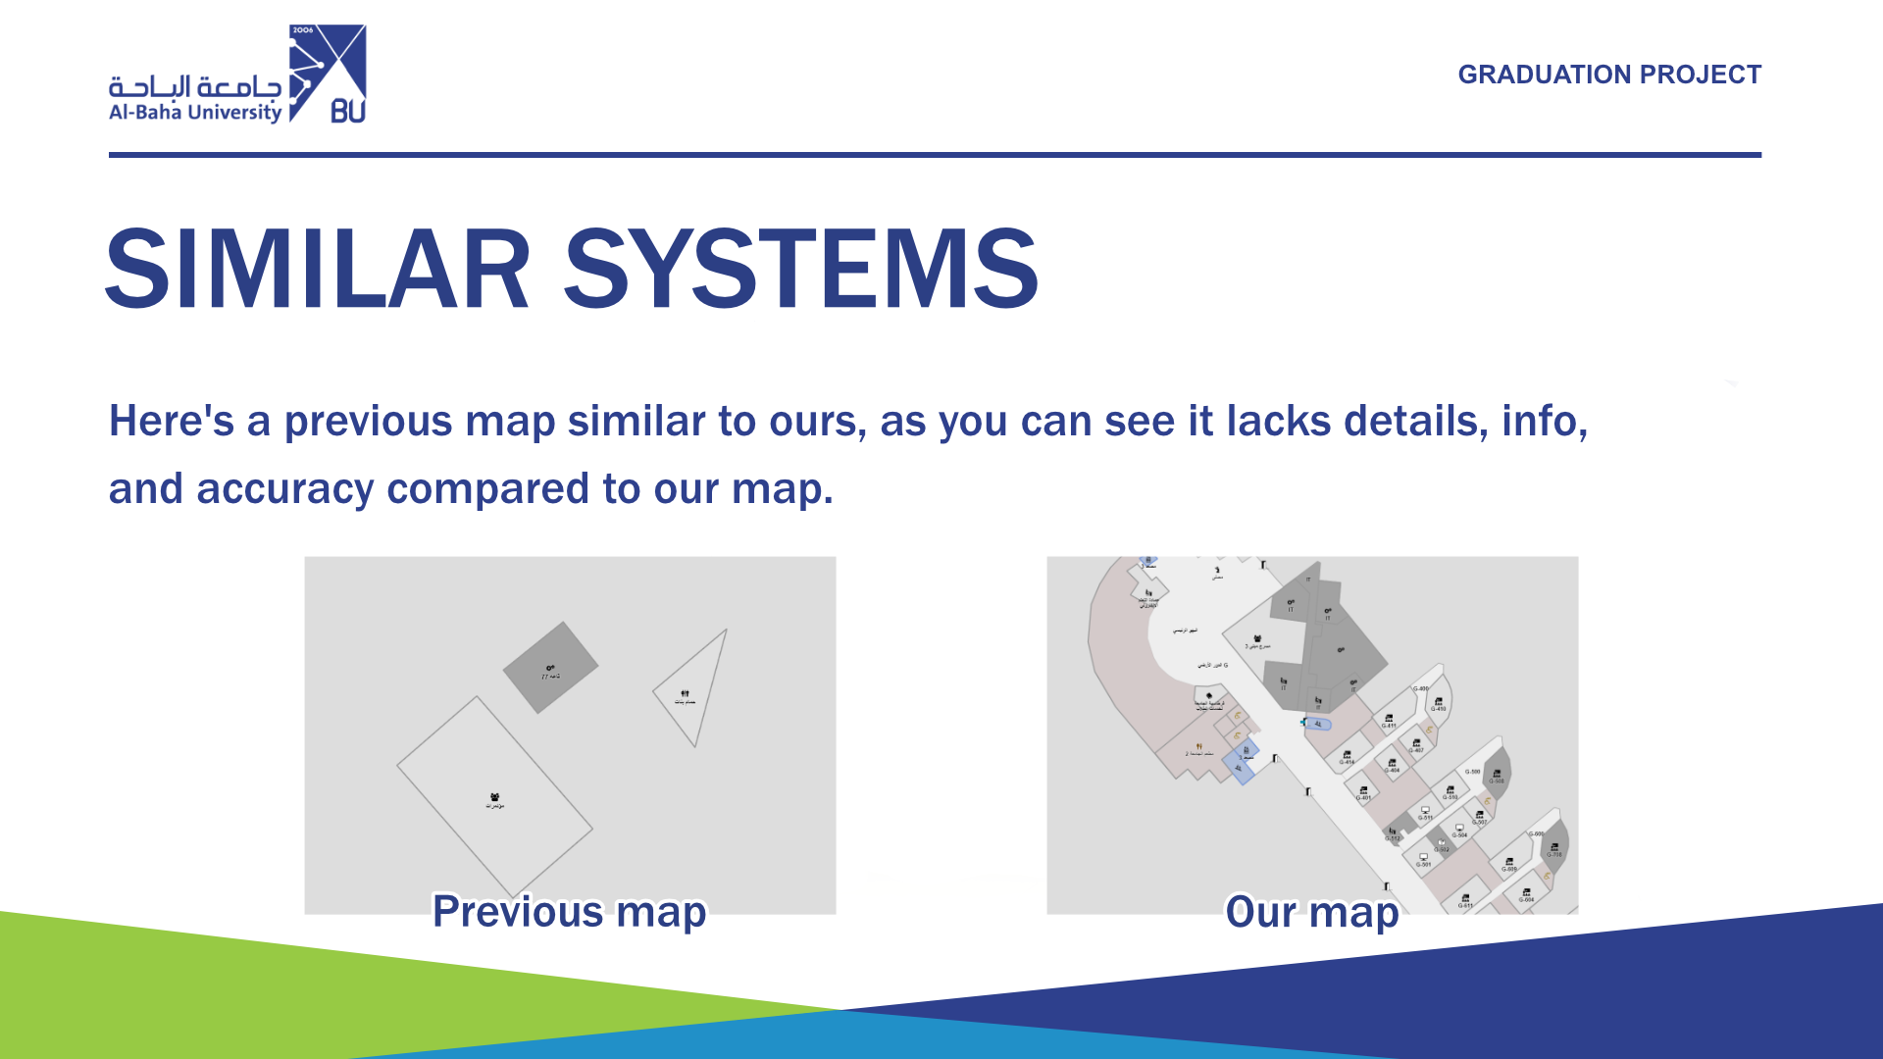

Slide 17
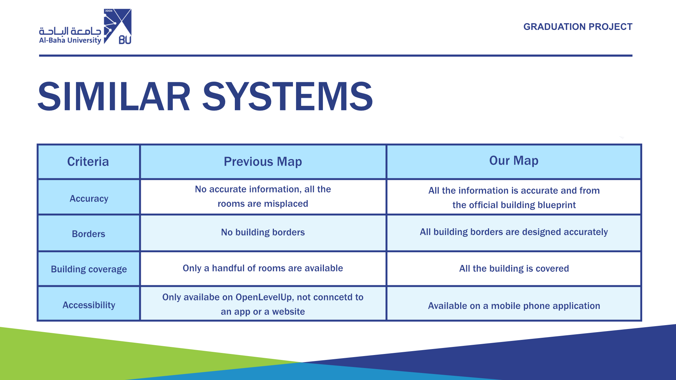

Slide 18
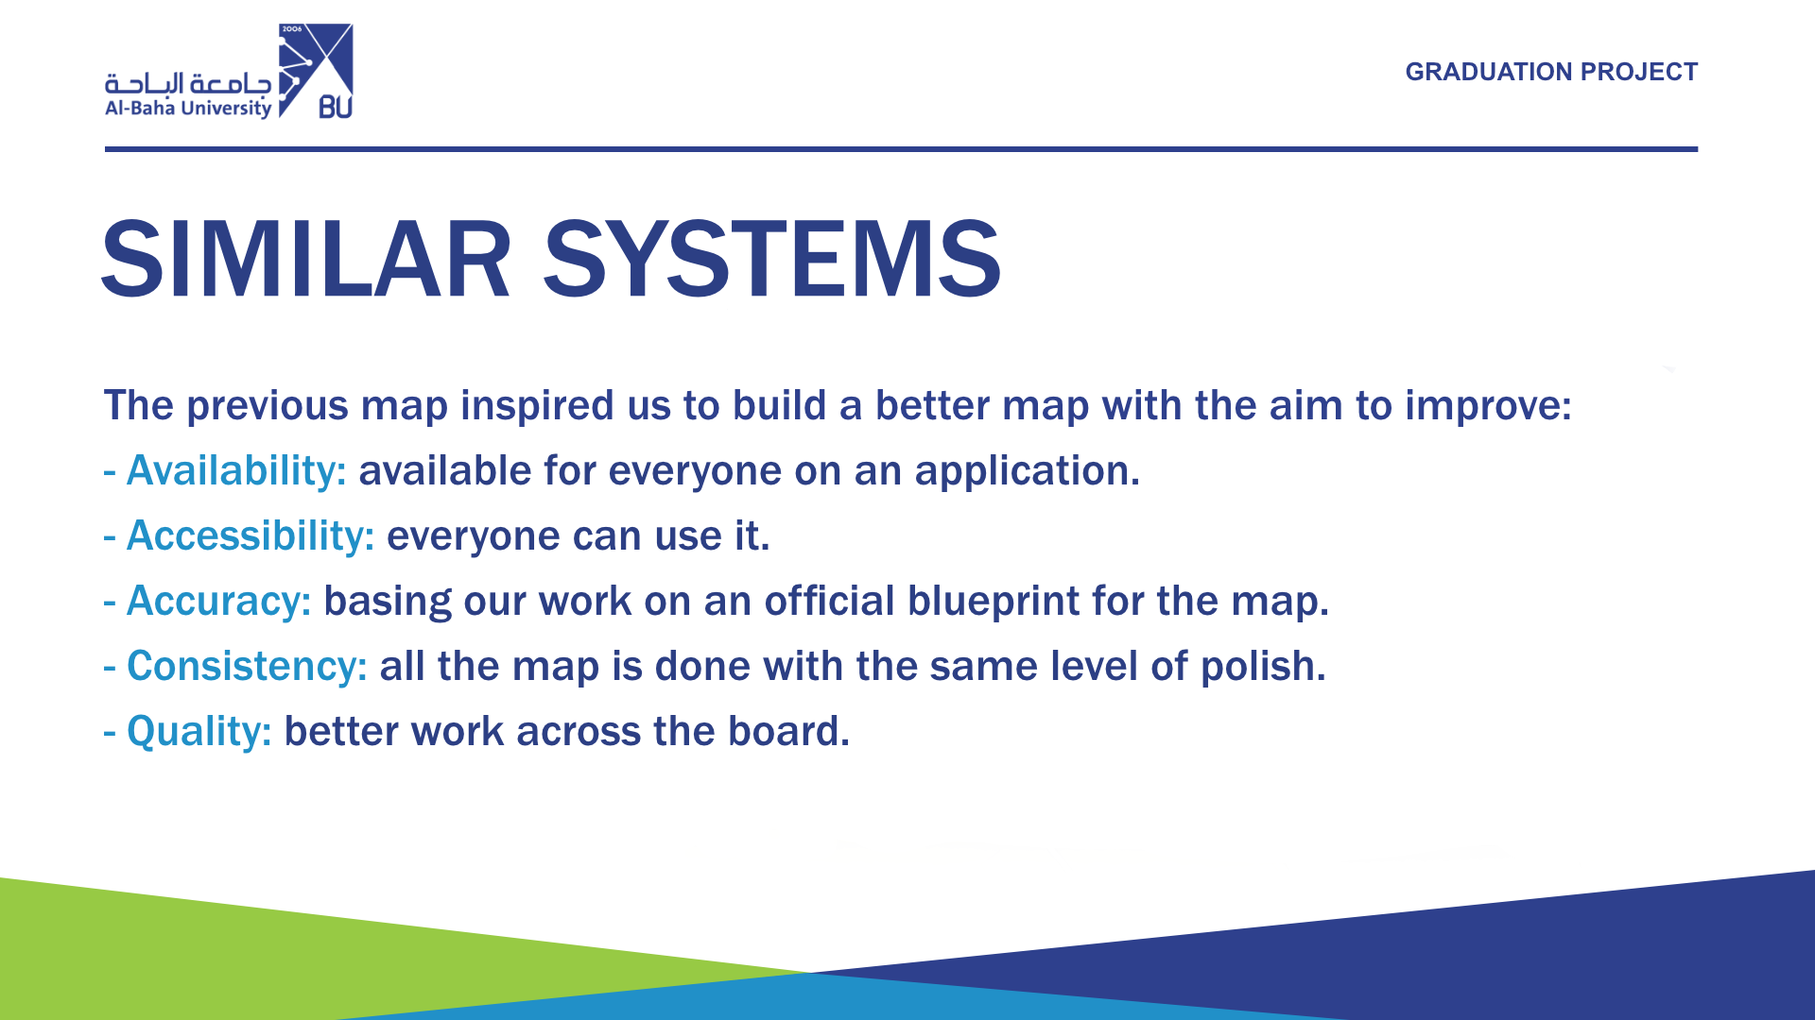

Slide 19
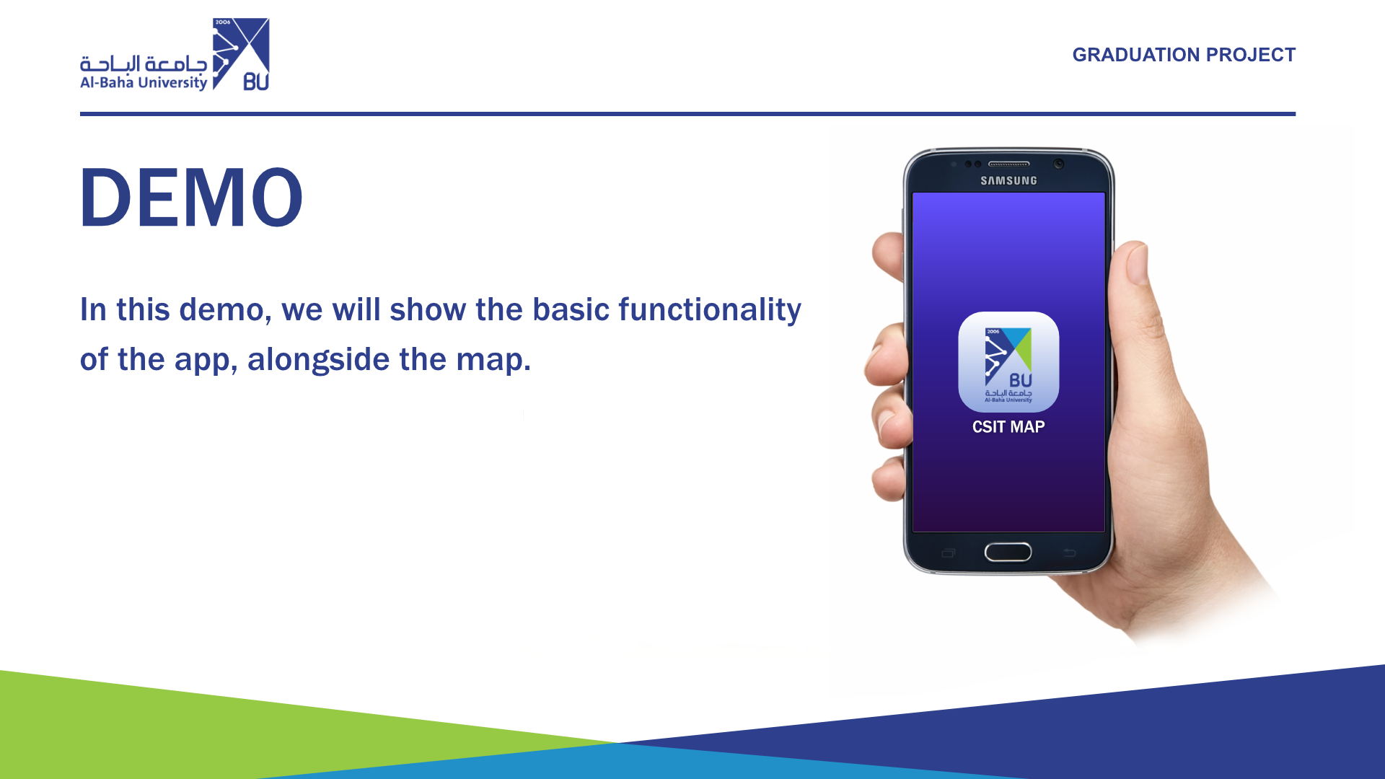

Slide 20
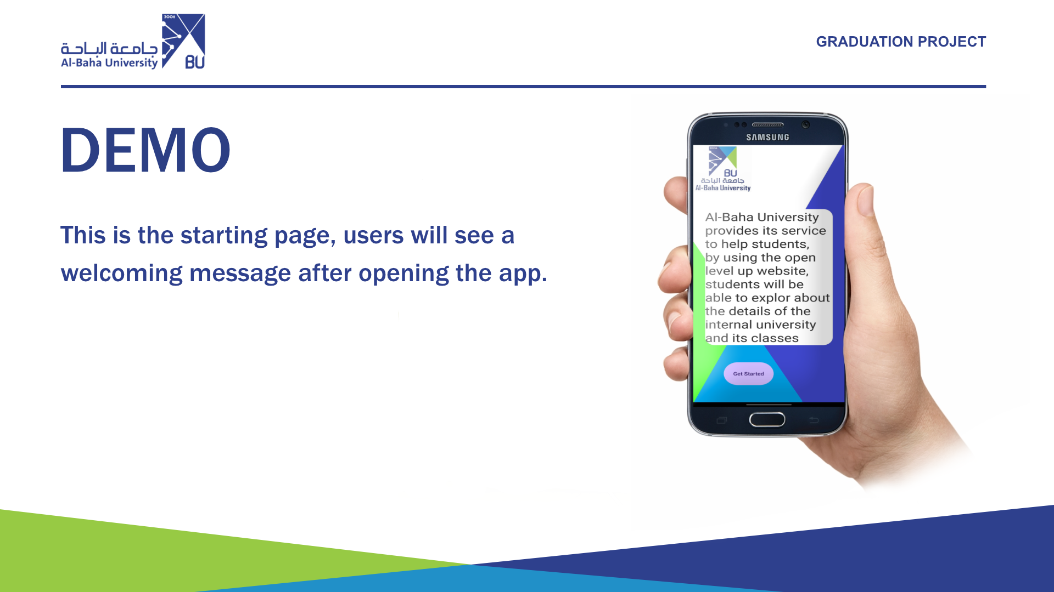

Slide 21
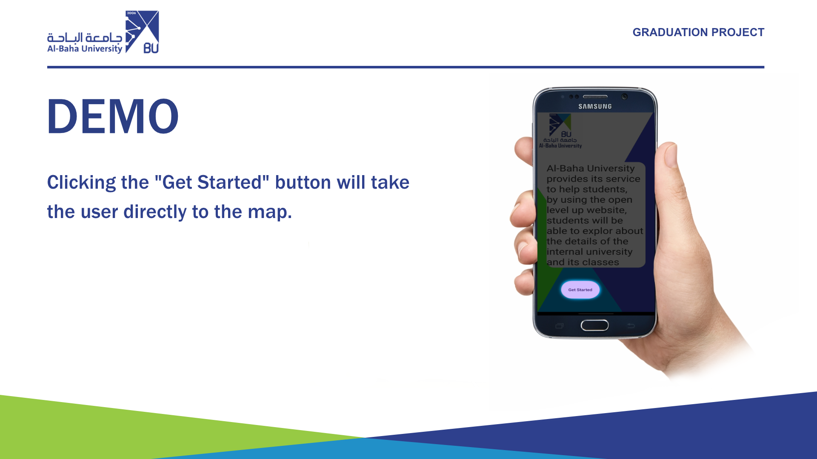

Slide 22
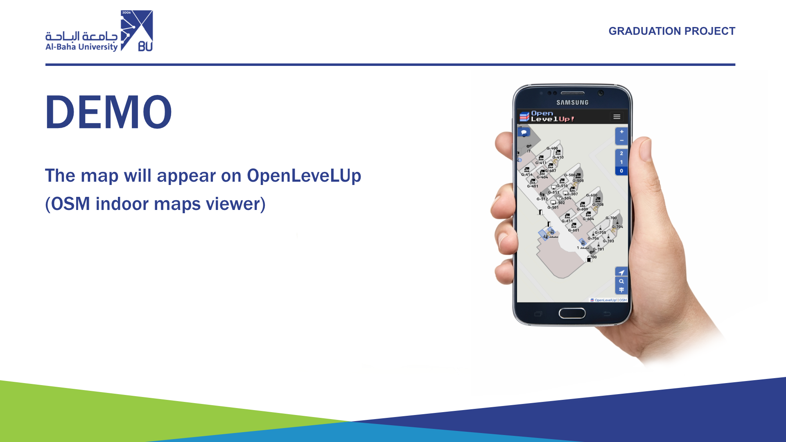

Slide 23


Slide 24
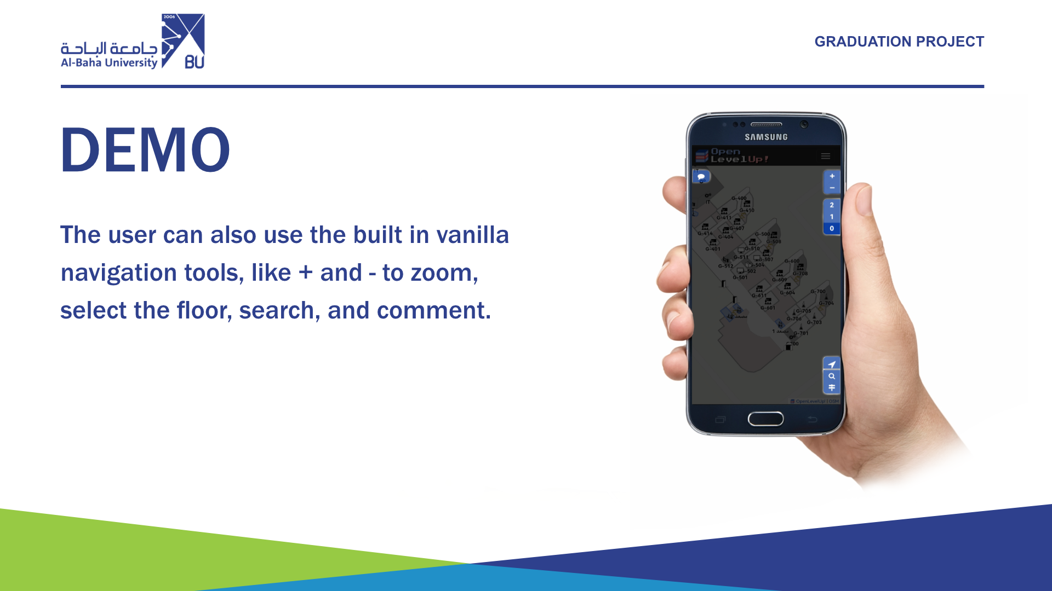

Slide 25
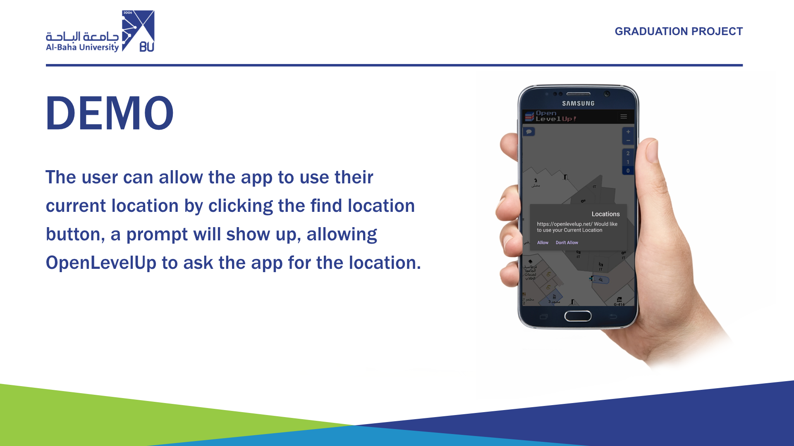

Slide 26


Slide 27
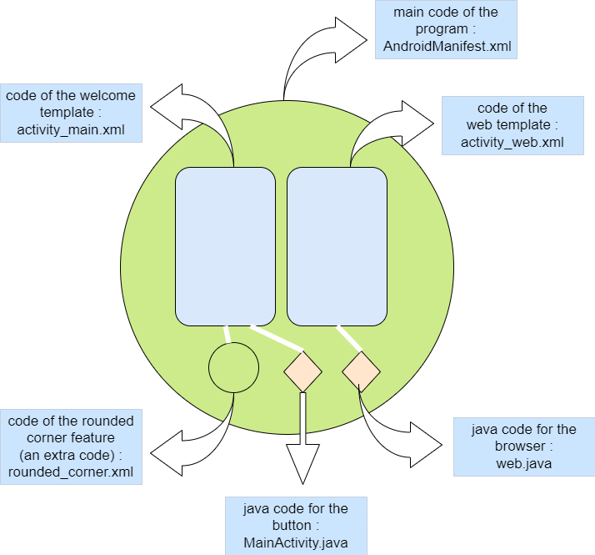
The program contains two templates
For each template the code consists of two main languages :
XML Section : For interface design and also is considered the basic code.
Java Section : To write functions

Slide 28
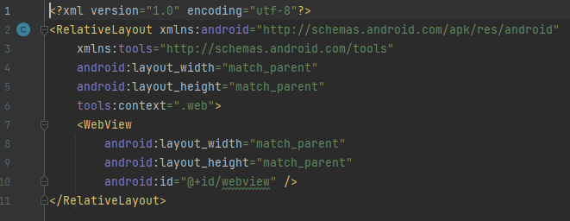
Example of an xml code
1- Using XML version 1.0, with utf-8 encryption
2 - By opening the relativeLayout tag, everything will be integrated within the boundaries of the screen and the possibility of modifying it+ give the template the access to use android features.
3- Give the template the access to use Android tools in Android Studio + the location of these tools
4+5 – The length and width of the template are the same as the length and width of the screen
6 – Template Name
7 – tag to create a browser
8 + 9 the length and width of the browser with the same length and width of the screen
10- Browser name

Slide 29
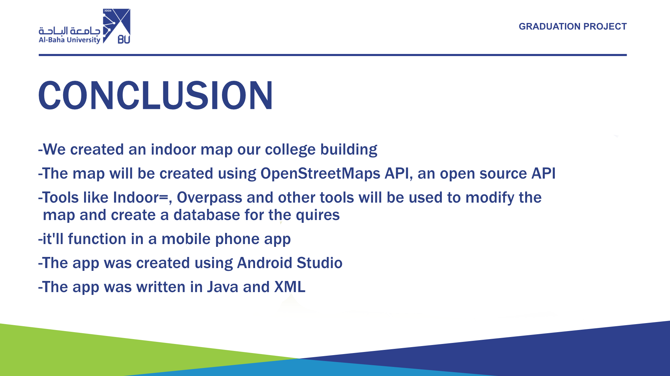

Slide 30


